Slide 1
Transport Layer Protocol.

Slide 2
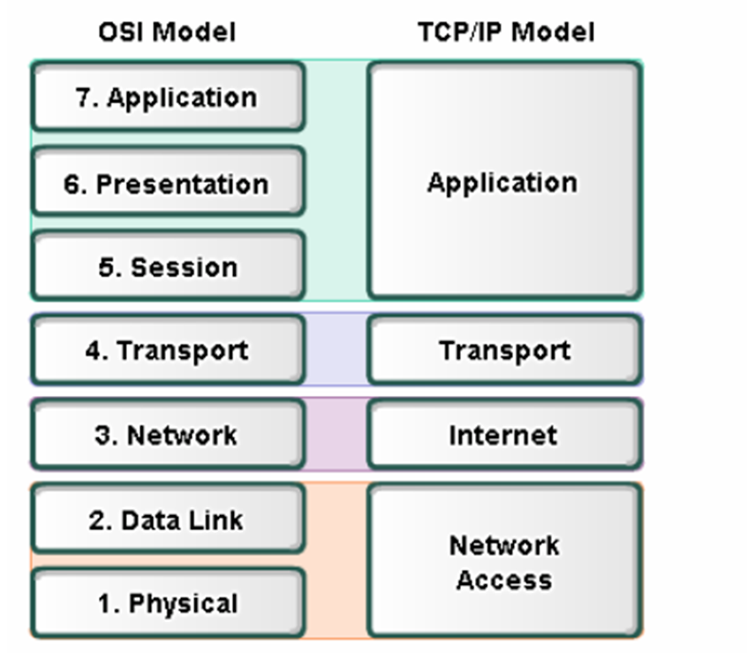

Slide 3
Transport layer protocol
The general service provided by transport layer protocol is the end-to-end transport of data from the sender to receiver and vice versa.
This protocol divides the sender information in to discrete message packets.
Then it delivers it to the receiver in the internet using a physical connection between them. At the receiving end it reassembles the received message packets into original data.
This also controls the data flow between the sender and receiver.

Slide 4
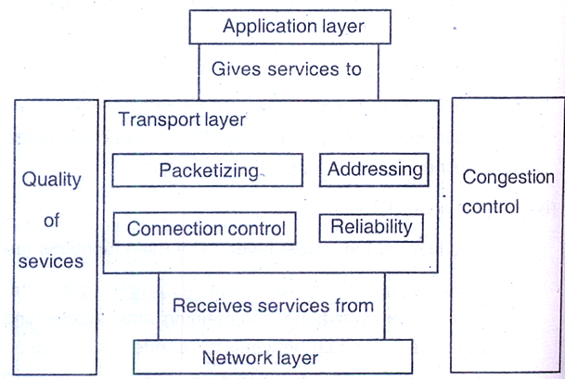

Slide 5
(i) Packetizing
This is a process of dividing a long message into smaller units called packets. Headers are added in each packet. In the receiving side, the data packets are reassembled to form the data string.
(ii) Connection control
This is responsible for establishing connection between the sender and the receiver. This can be either connection oriented or connectionless.

Slide 6
(iii) Addressing
The client needs the address of the remote computer to complete the communication. This addressing is implemented in the network layer.
(iv) Providing reliability
To guarantee the reliable delivery of data, acknowledgment and retransmission timers are used. Each time the data is sent a timer is started. If the receiver receives the data packet, it sends back the acknowledgment to the sender. If the sender won’t receive the acknowledgment packet with in the time, the data packet is retransmitted.

Slide 7
